Slide 1
Azure Data Factory Deep Dive
Jason Horner & Cathrine Wilhelmsen
SQLBits · February 27th 2019

Slide 2
Abstract
This immersive full day hands on session will arm you with all the skills you need to build and orchestrate pipelines using Azure Data Factory v2 that solve both traditional batch data integration problems and also adapt to newer challenges such as real-time and complex event processing.
We will start with a conceptual overview, and then get into how you can use metadata to build scalable serverless pipelines to move data from disparate data sources including On-Premises and Platform As A Service. We will look at how to leverage SSIS Lift and shift to maximize reuse for your existing code base and review the pros and cons of this approach. We will dive deep into the newly released Data Flow capabilities and cover the design patterns and architectures for modern Data Warehouses and big data pipelines. We will also review best practices for operationalizing solutions including configuring monitoring, logging and alerting. And did I mention DevOps? We will implement DevOps best practices like CI/CD within the data factory.
This day is everything you need to do amazing things with Azure Data Factory.

Slide 3
Welcome! :)

Slide 4
Us?

Slide 5


Jason Horner, Attunix
International Man of Leisure
jason@jasonhorner.com
@jasonhorner
Cathrine Wilhelmsen, Inmeta
Master Yak Shaver
hi@cathrinew.net
@cathrinew

Slide 6


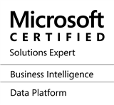




Jason Horner
I Do Stuff
SQL Server DW / OLTP, Azure, MDM, PowerShell, Geospatial Data, Advanced Data and Analytics, SSIS, SSAS
I Know Stuff
International Man of Leisure
@jasonhorner
jasonhorner.com
Papa Needs Brand New Shoes
Always looking for new meaningful and interesting work: jason@jasonhorner.com
http://www.jasonhorner.com/hireme.html
/jasonhorner
jason@jasonhorner.com

Slide 7

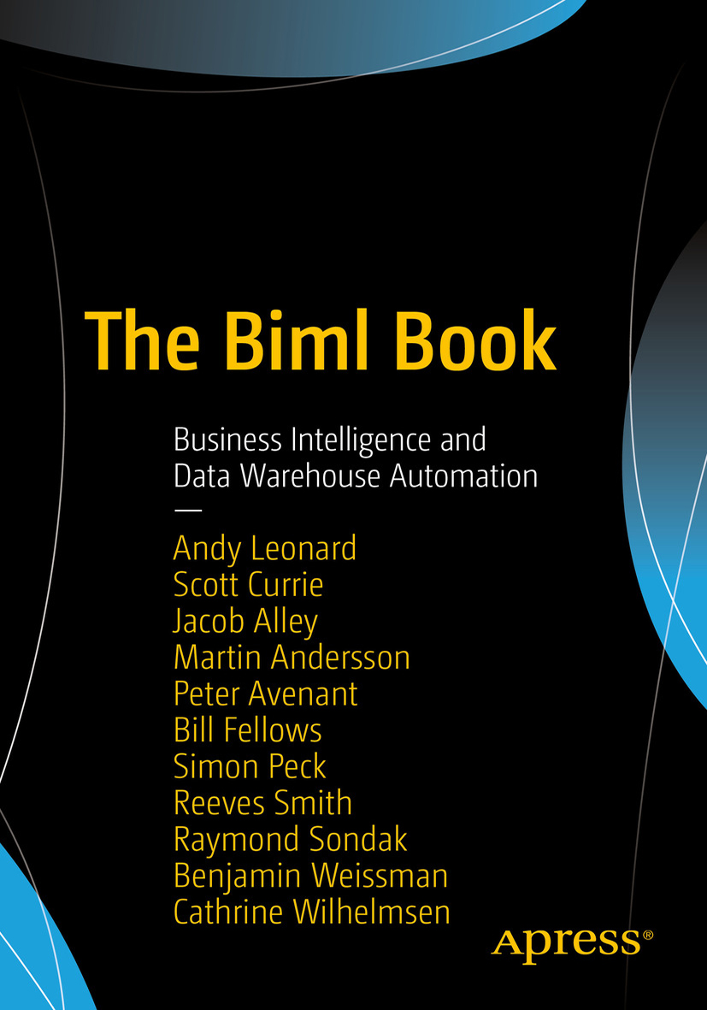

Cathrine Wilhelmsen
Work Things
Business Intelligence Consultant in Inmeta, focusing on the Microsoft Data Platform. Specialties: ETL, SSIS, Biml and T-SQL
Geeky Things
Master Yak Shaver
@cathrinew
hi@cathrinew.net
Fun Things
Active in the PASS and Biml communities as an author, speaker, blogger and chronic volunteer. Likes: coffee, chocolate and cat gifs :)
/cathrinewilhelmsen
cathrinew.net

Slide 8
You?

Slide 9
Today?

Slide 10
Ask Questions

Slide 11
Make Friends

Slide 12
Tweet

Slide 13

@jasonhorner @cathrinew #SQLBits #AzureDataFactory

Slide 14
Have Fun :)

Slide 15
Agenda?

Slide 16
Part 1: Azure Data Factory Overview
Concepts and Objects
Naming Rules and Conventions
Security
Pricing

Slide 17
Part 2: Basic Azure Data Factory
User Interface and Navigation
Pipelines
Annotations
Basic Activities

Slide 18
Part 3: Advanced Azure Data Factory
Dynamic Content
Variables
Iteration and Conditionals
Advanced Activities

Slide 19
Part 4: Azure Data Factory Design Patterns
Pipeline Templates
Architectural Patterns
Load Patterns
Auditing and Logging Patterns
Notes:
Metadata and Logging
Parent-Child
Bulk Table Transfer
Incremental Load
Activity Orchestration

Slide 20
Part 5: Azure Data Factory Data Flows
Transformations
Schema Drift
Performance
Test and Debug
Expression Language

Slide 21
Part 6: SSIS in Azure Data Factory
Integration Runtime
Deployment and Execution
Scheduling

Slide 22
Part 7: Operationalizing Solutions
Source Control and ARM Templates
CI / CD and DevOps
Logging, Monitoring and Alerting

Slide 23
Schedule?

Slide 24



09:00 - 09:15
09:15 - 10:15
10:15 - 11:00
11:00 - 12:30
12:30 - 13:30
13:30 - 15:00
15:00 - 15:45
15:45 - 16:45
16:45 - 17:00
Welcome
Precon
Lab & Coffee Break
Precon
Lab & Lunch
Precon
Lab & Coffee Break
Precon
Wrap Up

Slide 25
Let's go! :)

Slide 26

Azure Data Factory

Slide 27
Documentation
Azure Data Factory Documentation:
docs.microsoft.com/en-us/azure/data-factory/

Slide 28
Social Media
Azure Data Factory on Twitter:
@DataAzure

Slide 29
Interact with Product Teams
Azure Advisors on Yammer:
yammer.com/azureadvisors

Slide 30
Request a Feature
Azure Data Factory UserVoice:
feedback.azure.com/forums/270578-azure-data-factory

Slide 31
Updates
Azure Data Factory Updates:
azure.microsoft.com/en-us/updates/?tag=data-factory

Slide 32
Provide Feedback
Survey:
https://ca.surveygizmo.com/s3/50031989/Azure-Data-Factory-V2-GA

Slide 33
That's a wrap :) (Phew!)

Slide 34








Slide 35
Resources
URL to our Slide Deck
URL to our Demos

Slide 36
Thank you!
Jason Horner, Attunix
jason@jasonhorner.com
@jasonhorner
Cathrine Wilhelmsen, Inmeta
hi@cathrinew.net
@cathrinew

